Slide 1
HW 7
Maliha Hasan
UIN 658264611

Slide 2
INTRODUCTION
Creating a web page about me using HTML, CSS, and Javascript. This powerpoint will explain the special functions/features used to create webpage with screenshots to display the results

Slide 3
Visual Studio Code
In order to make a creative and interactive webpage, I used Visual Studio Code as my text editor. Through this I was able to create html, css and javascript files under one editor while constantly managing the changes I made as I created the webpage

Slide 4
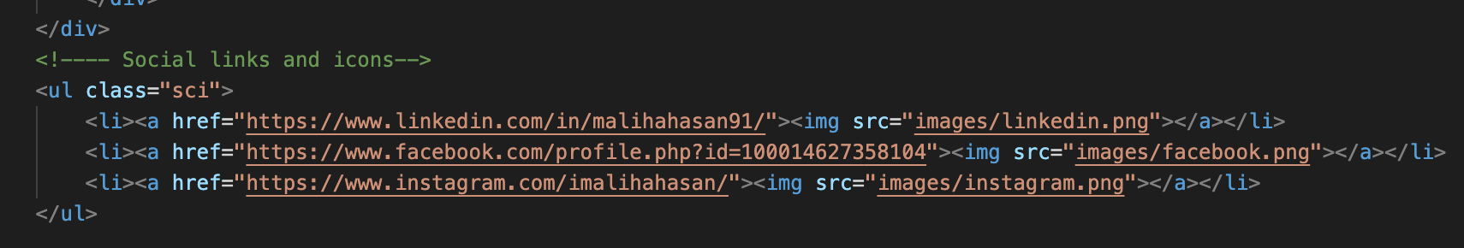
Special feature 1
Used social icons and connected them to website links

Slide 5
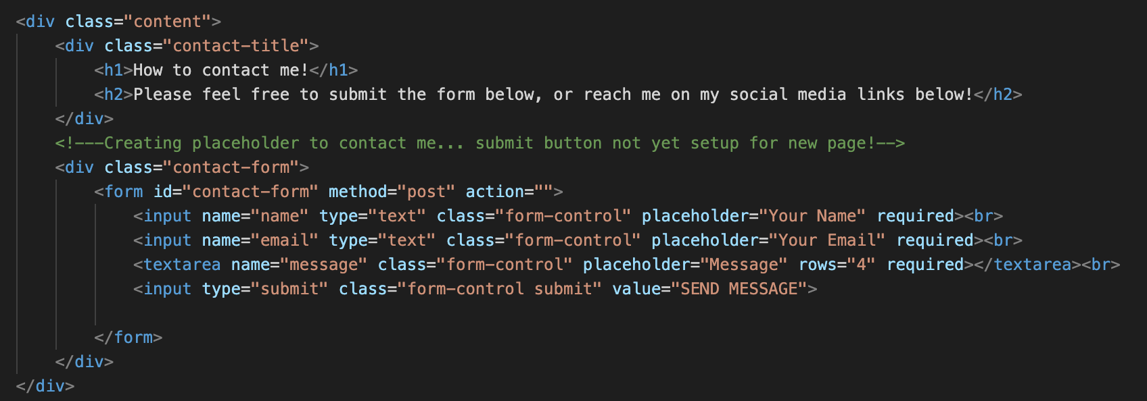
Special feature 2
Used form feature to create a send message page by utilizing placeholders

Slide 6
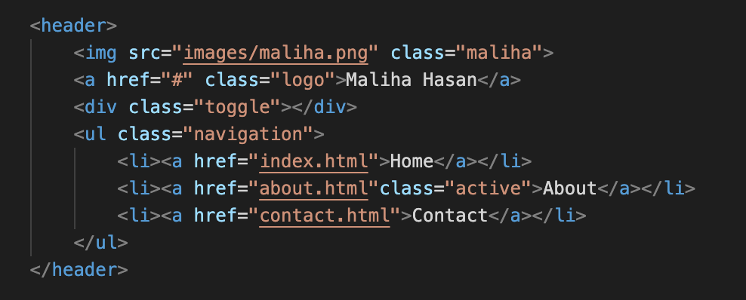
Special feature 3
Created a top menu bar to navigate to different pages of the website

Slide 7
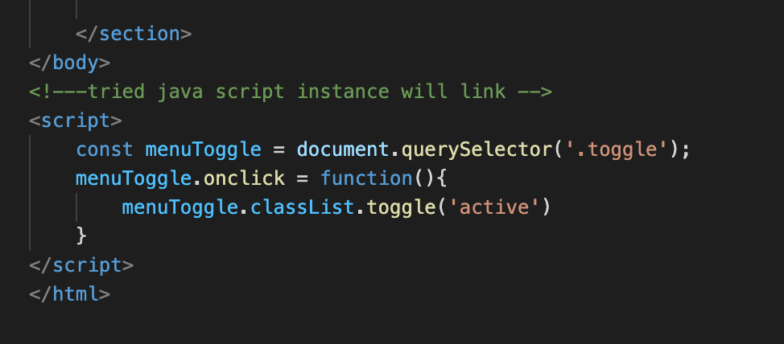
Special feature 4
Tried using javascript to make menu toggle between sections on the webpage

Slide 8
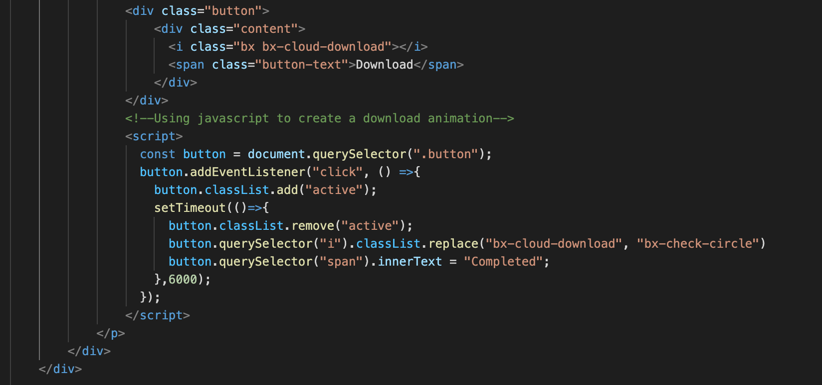
Special feature 5
Used javascript to create an animated download button with progress bar
-Once download button is clicked progress bar is activated and changes to ‘completed’ when end of bar is reached
- Utilized ‘transition’ and ‘transition delay’ in css to create the transition effect for progress bar

Slide 9
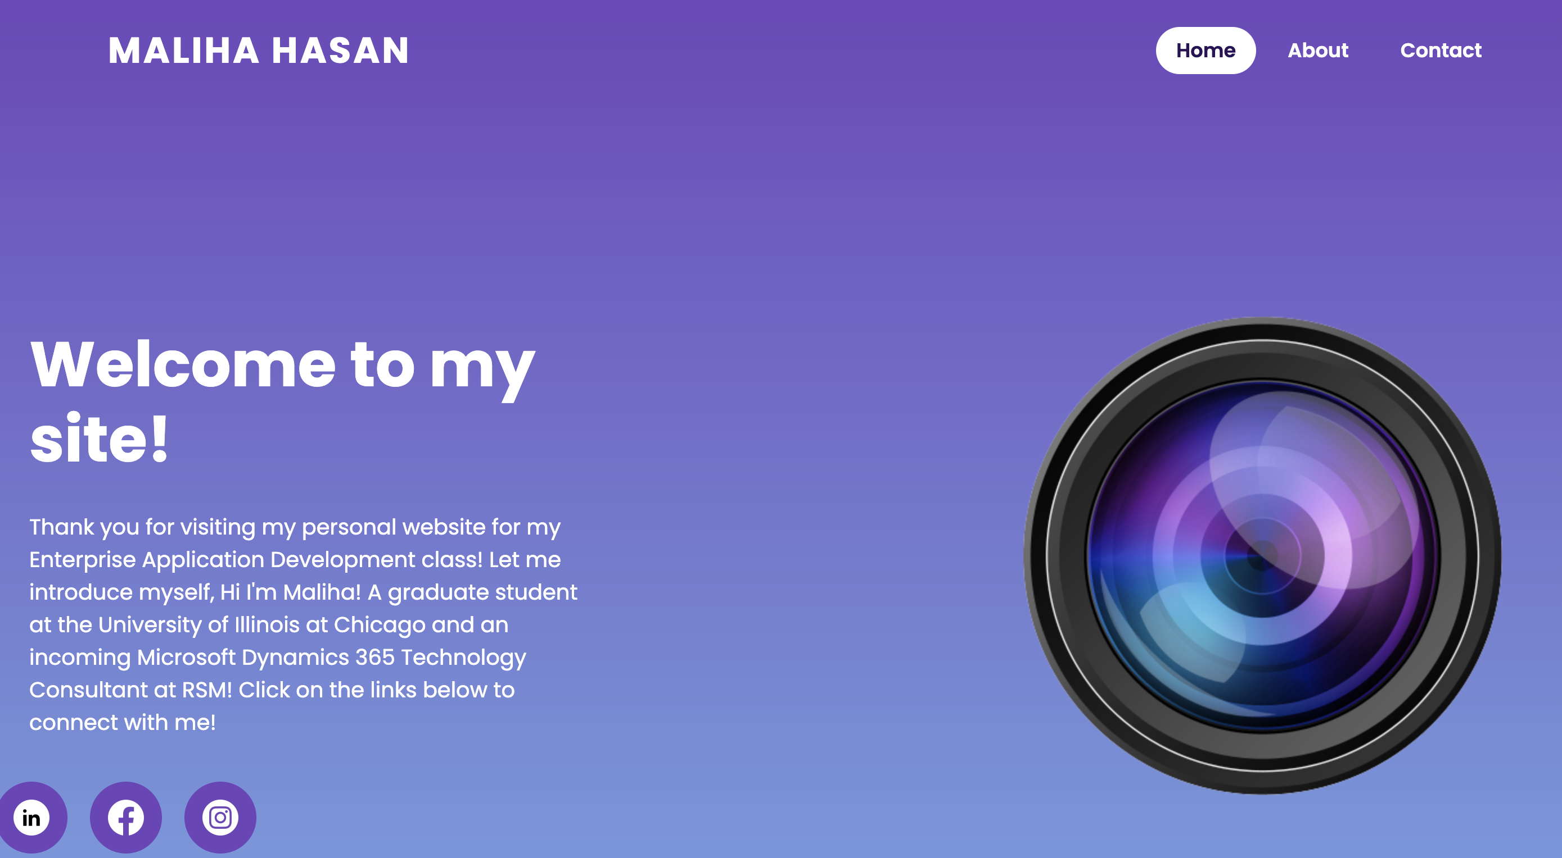
Landing Page

Slide 10
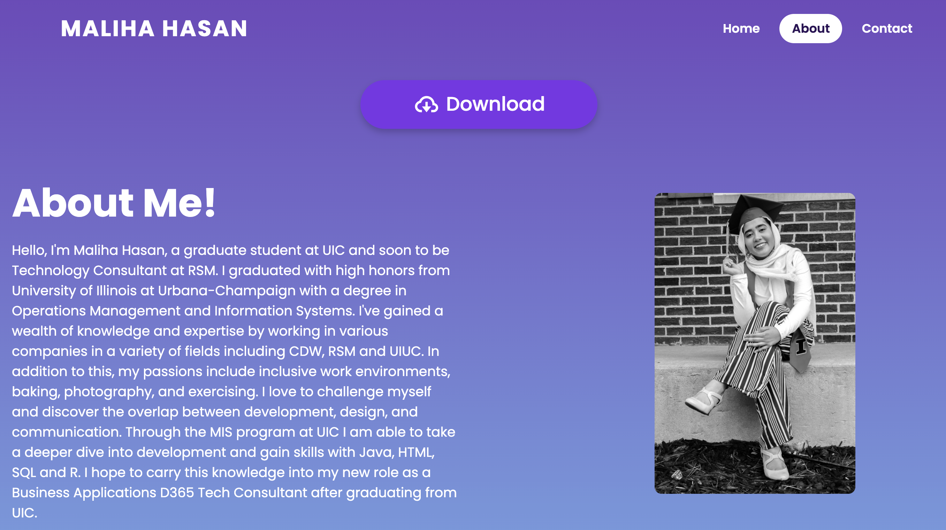
About Page

Slide 11
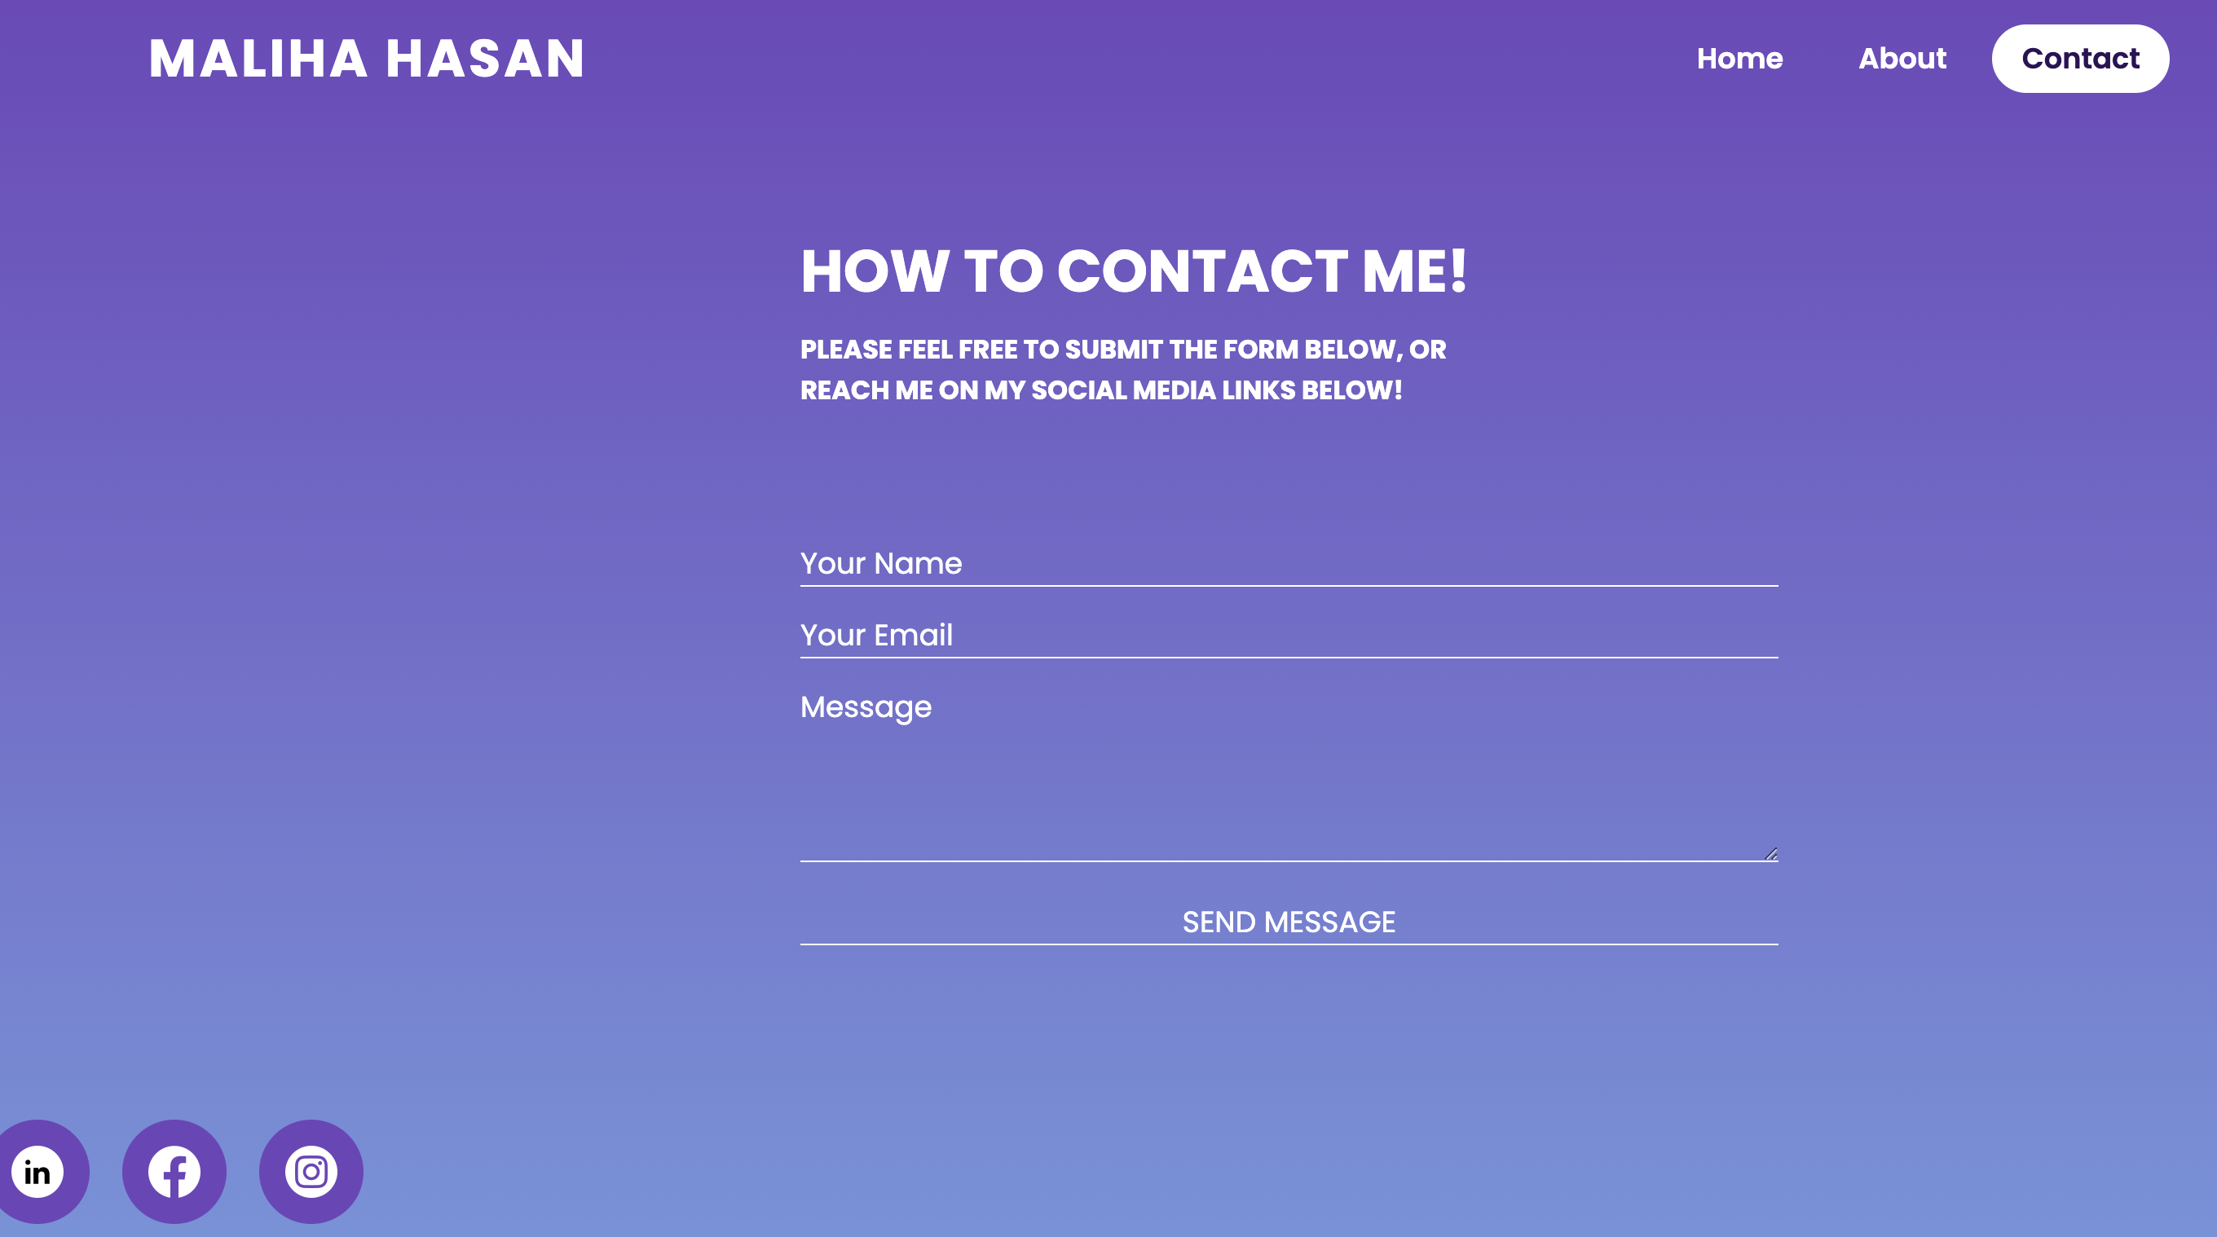
Contact Page

Slide 12

Progress Bar animation
Click on the video to see the animation!

Slide 13
Challenges
CHALLENGE
SOLUTION
RESULTS
- Tried to use javascript to toggle within the page to different sections
- Tried to add a pdf link to download animation was not able to time span
Used html and css instead to resolve the issue by creating separate pages for each menu option
Kept the animation as is
Spent lots of time to find colors, icon, and images that matched theme

Slide 14
THANKS

